Slide 1




AUTOMATIC UNAUTHORIZED PARKING SYSTEM USING RFID
TEAM MEMERS:
SHIVANI PATEL
AESHA PATEL
PALAK AMIN
AADRA MAJMUDAR

Slide 2
Introduction
An automatic unauthorized RFID parking system is a type of smart parking system that uses radio frequency identification (RFID) technology to detect and deter unauthorized parking. RFID tags are attached to vehicles that are authorized to park in a particular area. When a vehicle with an RFID tag enters the parking area, the tag is read by an RFID reader. The reader then sends the tag information to a central computer system, which validates the tag and allows the vehicle to park.
If a vehicle without an RFID tag enters the parking area, the RFID reader will not be able to read the tag and the vehicle will be flagged as unauthorized. The central computer system will then send an alert to security personnel, who can then take action to tow the unauthorized vehicle.
Automatic unauthorized RFID parking systems offer a number of advantages over traditional parking enforcement methods. They are more efficient, as they can detect unauthorized vehicles in real time and automatically send alerts to security personnel. They are also more effective, as they can deter unauthorized parking by making it more difficult for violators to avoid detection.

Slide 3
Problem Statement
Unauthorized vehicles can park in restricted areas, causing traffic congestion and safety hazards.
It can be difficult and time-consuming for security personnel to manually monitor parking areas for unauthorized vehicles.
Manual monitoring can also be inaccurate, leading to fines being issued to authorized vehicles or unauthorized vehicles being allowed to park without penalty.
An automatic unauthorized RFID parking system can help to solve these problems by automatically detecting unauthorized vehicles and issuing fines or towing them away.
This can free up security personnel to focus on other tasks, such as preventing crime and responding to emergencies.
It can also help to improve the efficiency and effectiveness of parking management.

Slide 4
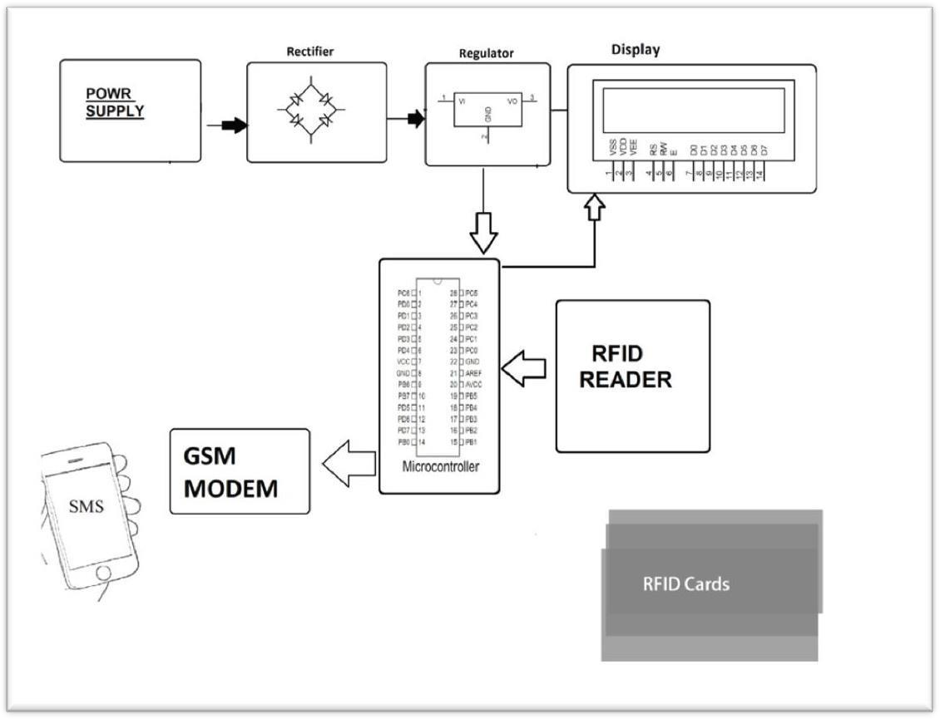
Block diagram
Figure : Block Diagram

Slide 5

Tools And Technology
Hardware Specifications | Software Specifications
Arduino NANO | Arduino Compiler
GSM Module | IOT
6v Regulator
Ribbon Cable
Display LCD
RFID CARD READER
Microware MIDI Extension Cable
RFID Card or Key Fob Security

Slide 6
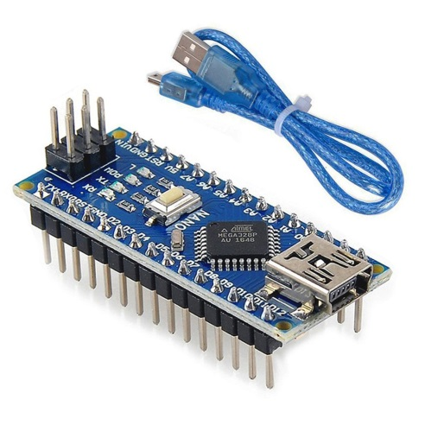
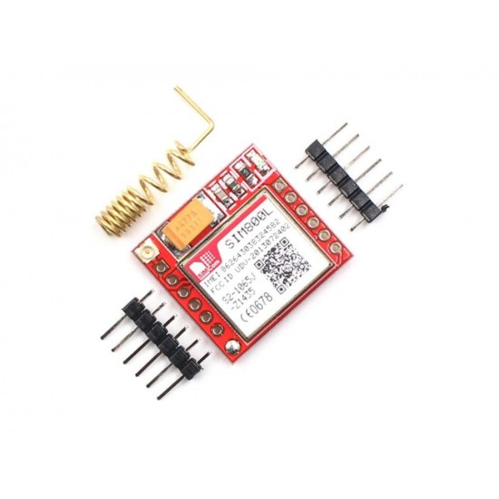
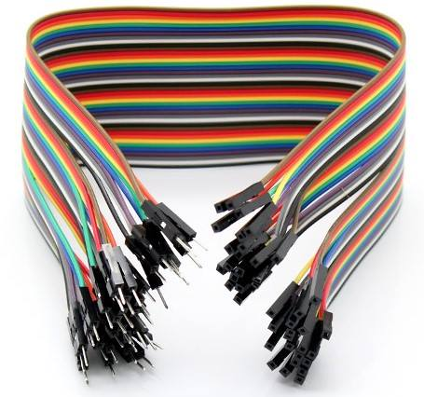
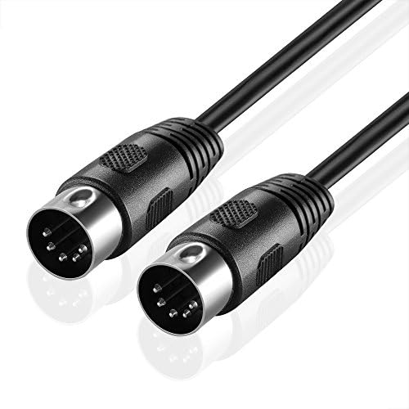
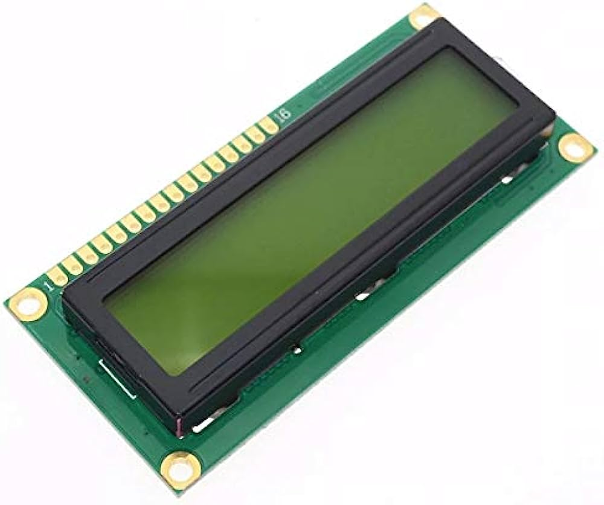
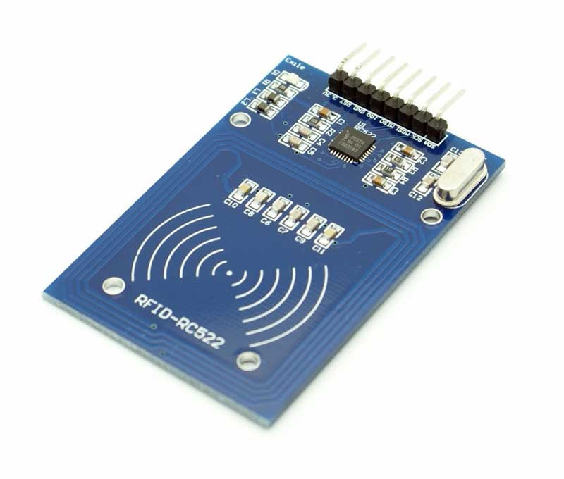
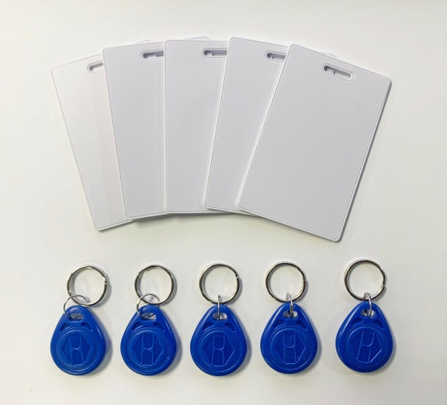
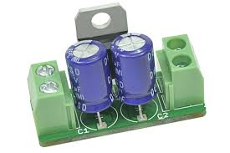
Arduino NANO
GSM Module
Ribbon Cable
Microware MIDI
Extension Cable
RFID CARD READER
RFID Card or
Key Fob Security
Display LCD
6v Regulator
Hardware Tools

Slide 7
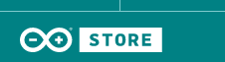

Software Technology

Slide 8
An automatic unauthorized RFID parking system uses radio frequency identification (RFID) technology to detect and deter unauthorized parking. The system typically consists of the following components:
RFID tags: These are small, passive devices that are attached to vehicles. They contain a unique identification number that can be read by an RFID reader.
RFID readers: These are devices that emit a radio signal that can be used to read the identification number of an RFID tag.
Gateway: This is a device that connects the RFID readers to a central database. The database stores the identification numbers of all authorized vehicles.
Central server: This is a computer that hosts the database and controls the operation of the system.
Notification system: This can be a text messaging system, email system, or other system that is used to notify the owner of an unauthorized vehicle.

Slide 9
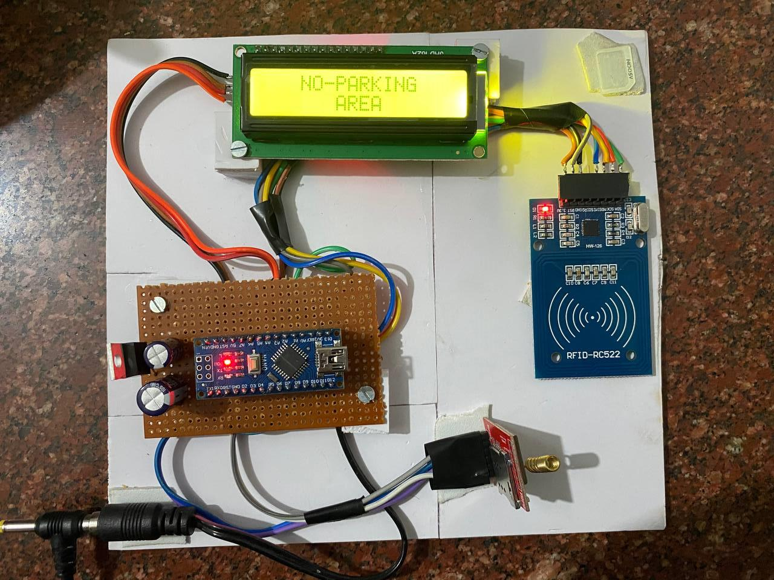
Screen shots of implemented work

Slide 10
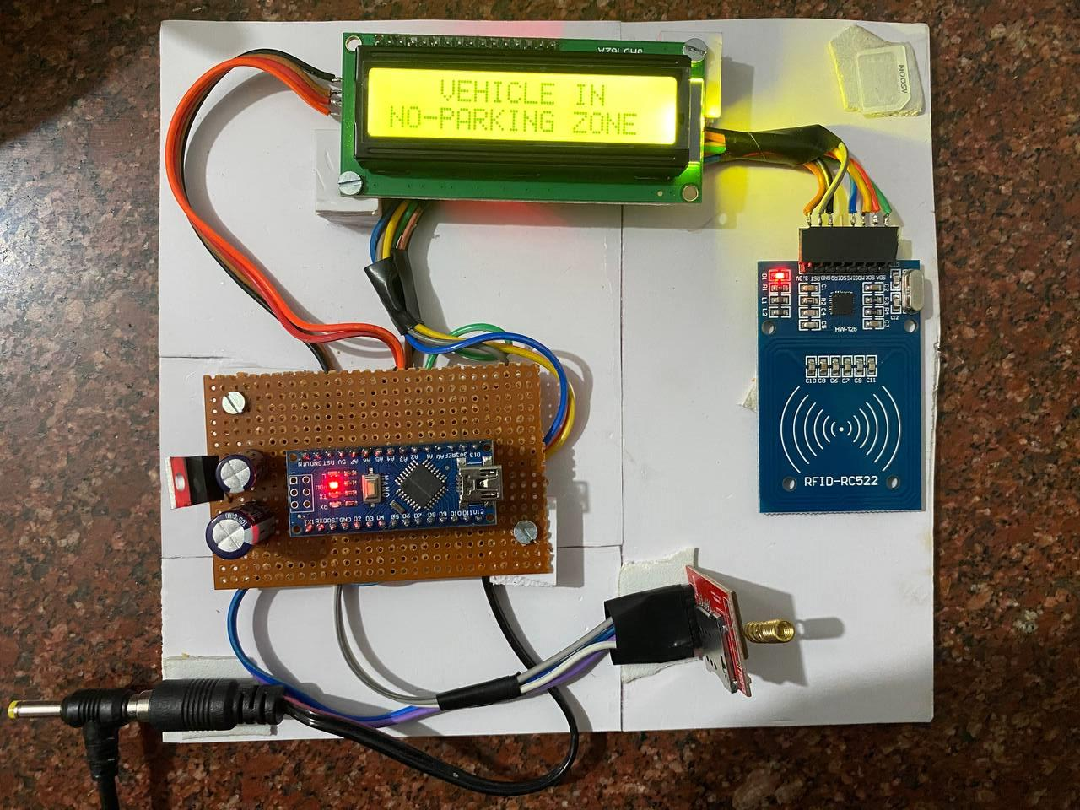
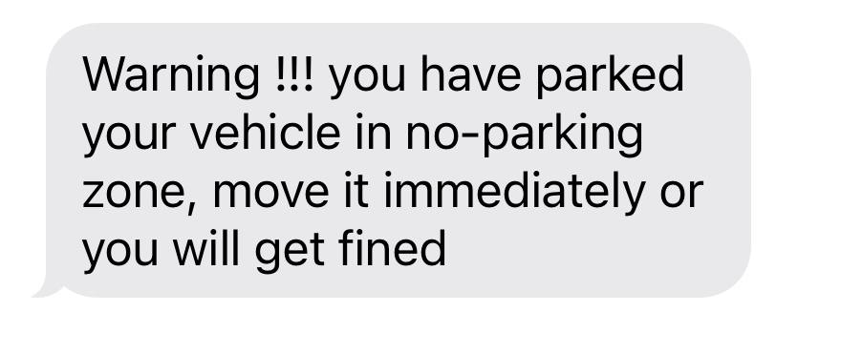
Screen shots of implemented work

Slide 11

Thank you

